Slide 1

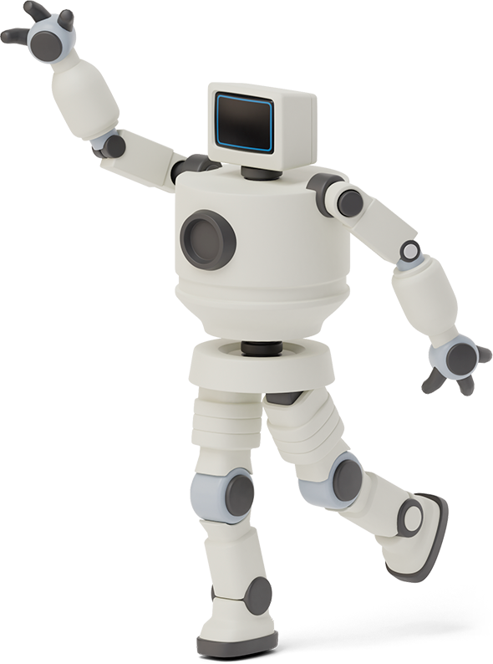


Slide 2


HANDWRITTEN DIGIT recognition

Slide 3

Team Presentation
ABDULLAH RAUF
SP19 – BSE – 007

Slide 4


Handwritten Digit recognition
1
Handwritten Digit Recognition is used to recognize the Digit which are written by hand.
Handwritten digit recognition is the ability of a computer to recognize the human handwritten digits from different sources like images, papers, touch screens.

Slide 5

IMPORTANCE
The task of handwritten digit recognition, using a classifier, has great importance and use
1980s: Start of retail handwriting digit recognition system with electronic pen and electronic tablet.
2007 : First automatic writer recognition system: CEDAR-FOX.

Slide 6

To Perform Digit Recognition, Some basic Knowledge on Neural Network (NN) and Image Processing is needed.

Slide 7
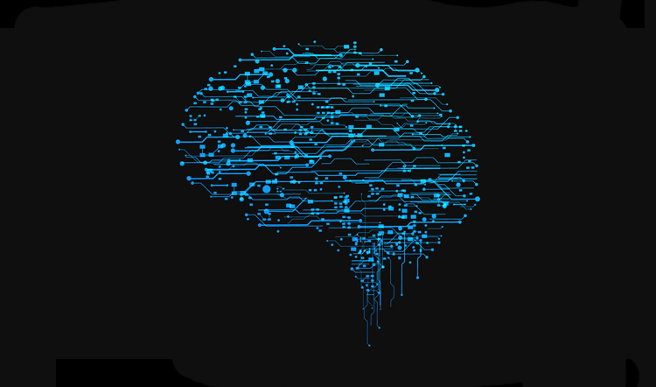
NEURAL NETWORKS
Artifical Neural Networks have been developed since 1940s.
Neural networks are designed to work just like the human brain does.
Artificial Neural Networks, usually called ANNs. System Composed of many simple processing elements (neurons) operating in parallel.
Whole function is determined by,
Network Structure
Connection Strength
Process Performed at Computing Elements or Nodes

Slide 8
Applications
A handwritten digit recognition system is used to visualize artificial neural networks.
Used it in surveillances system to keep tracks of the suspicious activity under the system
1
3
2
4
Used in the automatic processing of bank cheques, postal addresses, cell phones
The applications of digit recognition includes in postal mail sorting, bank check processing, form data entry

Slide 9


Few Techniques Used for recognition
HANDWRITTEN DIGIT REGONITION
DESKEWING
THINNING
SMOOTHING
RESIZING

Slide 10

Deskewing
Deskewing is the process of detecting and fixing this issue on scanned files so deskewed images will have the text/images correctly and horizontally aligned.
Benefit will be that we don’t have to scan in again the skewed documents.

Slide 11
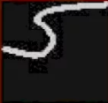


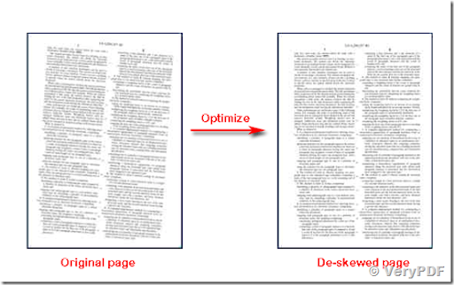

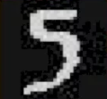

Left- leaning
Side slip
rotation
Right Leaning
Side slip
rotation

Slide 12




Threshold original
Thinning
The digit images are thinned to thickness of one pixel.
This Can lead undesired side-effect, such as spurs.
Thinned (with spurs)
Pruned (by 5 pixels)

Slide 13
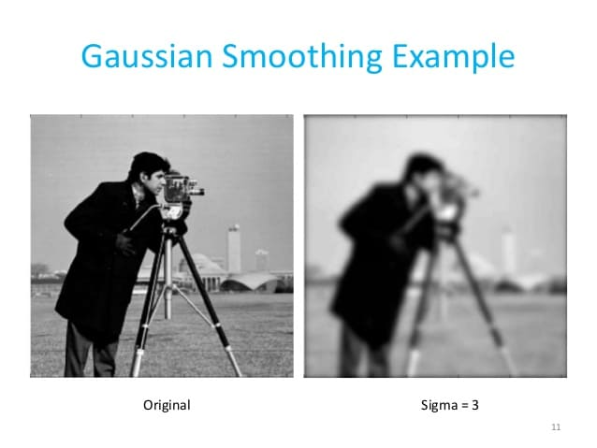
smoothing
Some acquisition methods may cause small artifacts on the digit's edges. These are removed by a smoothing operation.
Effective smoothing can be accomplished by filling tiny gaps in both the foreground and the background.

Slide 14
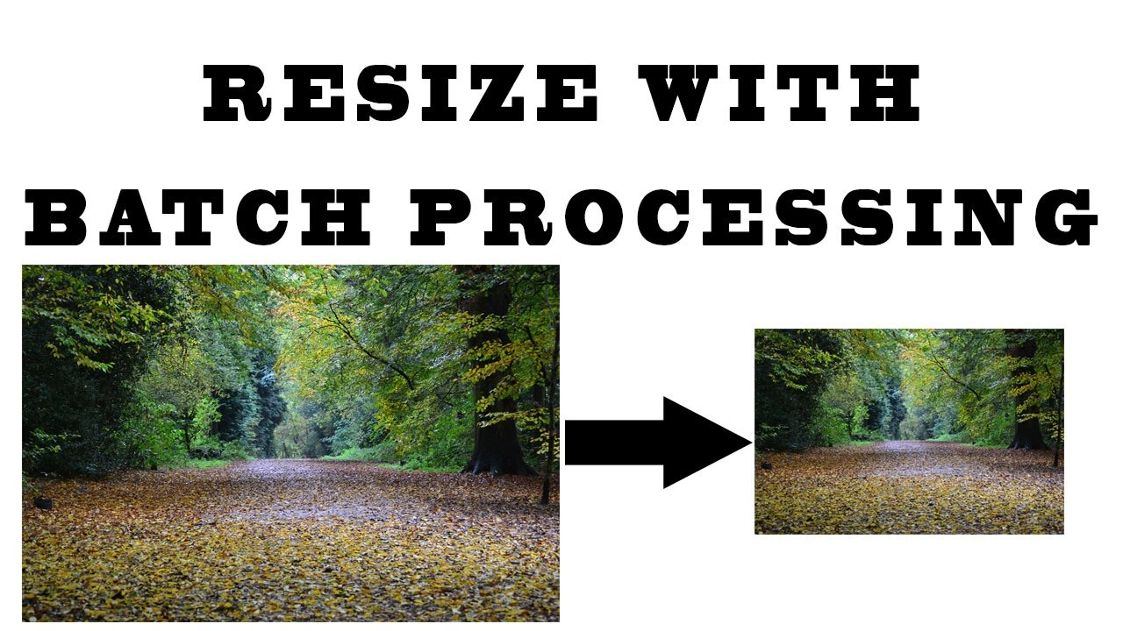
resizing
Difference in digit size are due to different image resolutions and handwriting styles.
To minimize the effect of these differences, all digits are resampled / rescaled to the same size in pixels, before being fed to the recognizer.

Slide 15

result
A neural network which is trained with 10000 handwritten digits images from in image database, is shipped together with this library as default neural network model.
By performing benchmarking on 8950 handwritten digit images from image database then we get some recognition rate.

Slide 16
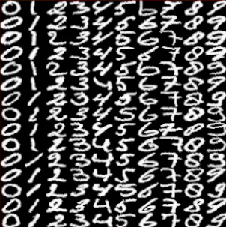
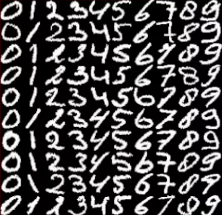
Testing & Training
TRAINING DATA
TESTING DATA

Slide 17
supervised machine learning algorithm
SUPPORT VECTOR MACHINE
MULTILAYERED PERCEPTRON
CONVOLUTIONAL NEURAL NETWORK
VISUALIZATION

Slide 18

CODE
Handwritten Digit Recognition
Python Code

Slide 19

Libraries & Training Dataset

Slide 20
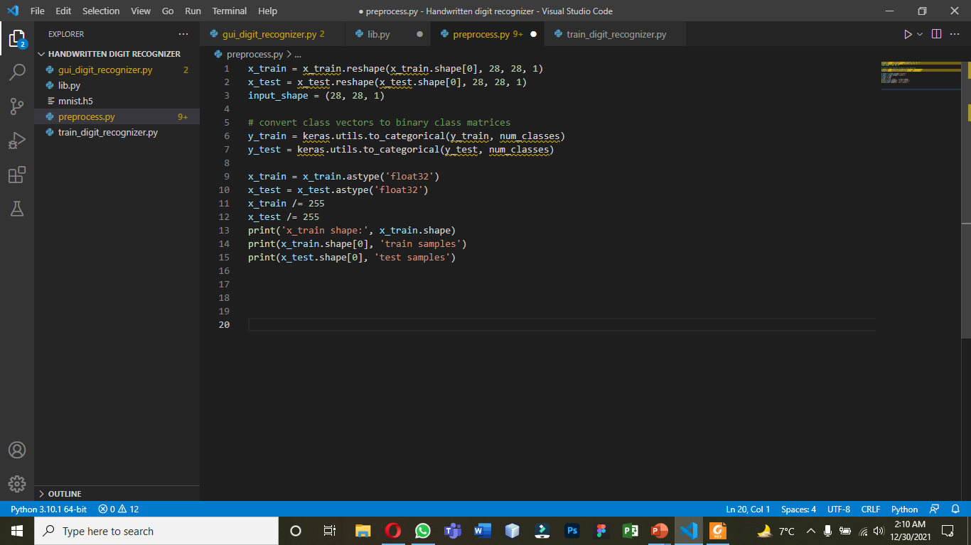
Preprocess data

Slide 21

Create the model

Slide 22

Train the model

Slide 23

Evaluate the model

Slide 24

Create GUI to predict digits

Slide 25
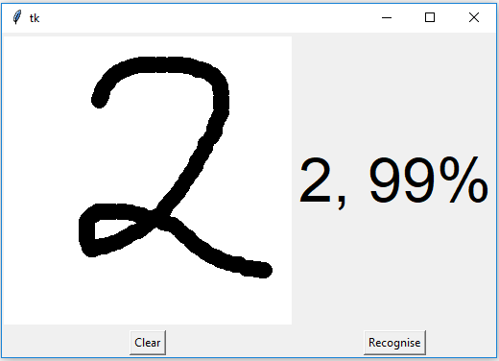
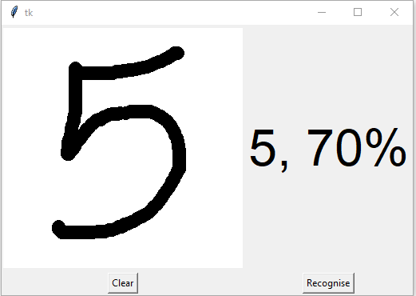
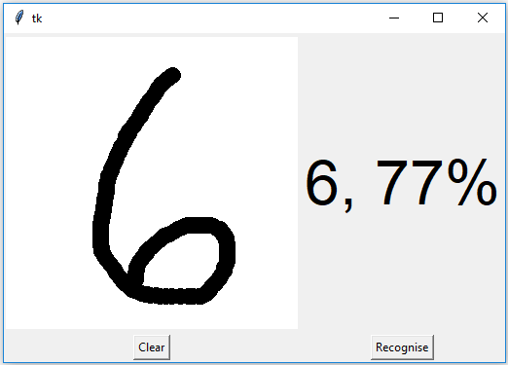
Screenshots

Slide 26
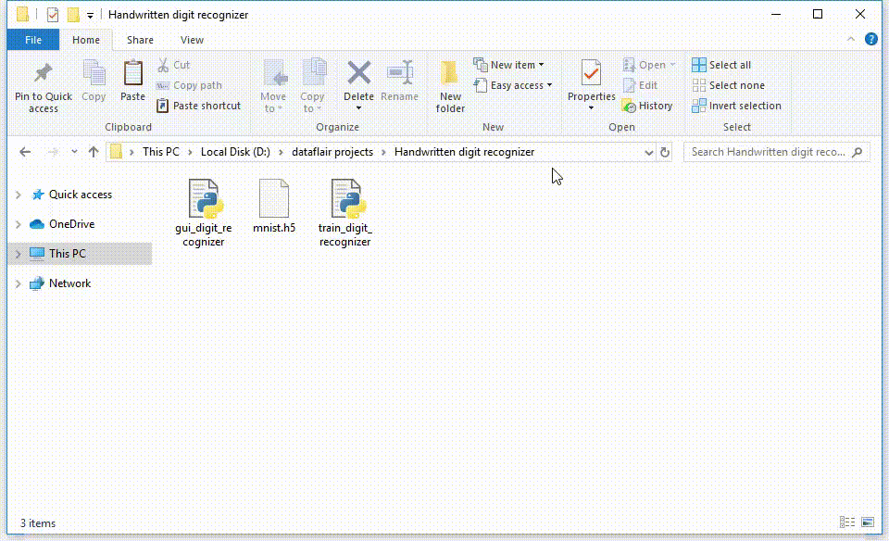
Project output

Slide 27
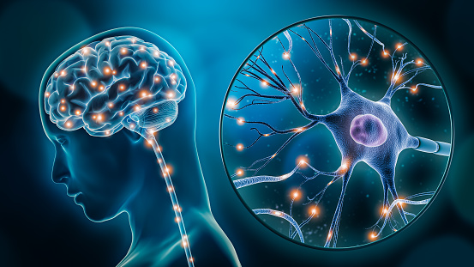
Mobile Demo

Slide 28
Thanks!
Any questions?

Slide 29
REFERENCES
https://arxiv.org/pdf/2106.12614.pdf
https://www.researchgate.net/profile/Younes-Alwan/publication/316938847_Handwritten_Digit_Recognition_Using_Convolutional_Neural_Networks/Handwritten-Digit-Recognition-Using-Convolutional-Neural-Networks.pdf
https://www.sciencedirect.com/science/article/abs/pii/S0031320303000852
https://ieeexplore.ieee.org/abstract/document/165597

Slide 30


